Slide 1
Systemic Lupus Erythematosus (SLE)
Pathogenesis
Abnormal Immune Function
Formation of Autoantibodies
Pathophysiology
Development of excessive autoantibodies & immune complexes
Antibodies to nuclear, cytoplasmic, and cellular surface components
Hyperactive lymphocytes & impairment of immune regulation
T cells (CD8-suppressor T cells)
Release of cytokines--Ils, γ-interferon, TNF

Slide 2
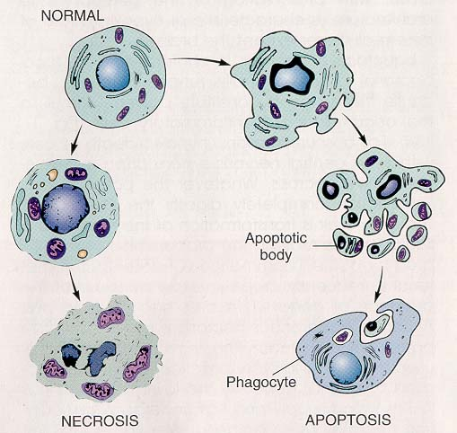
Normal Pathway of Apoptotic Cell Clearance

Slide 3
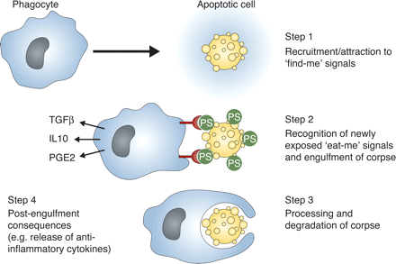
Normal Pathway of Apoptotic Cell Clearance
http://jem.rupress.org/content/207/9/1807.figures-only

Slide 4
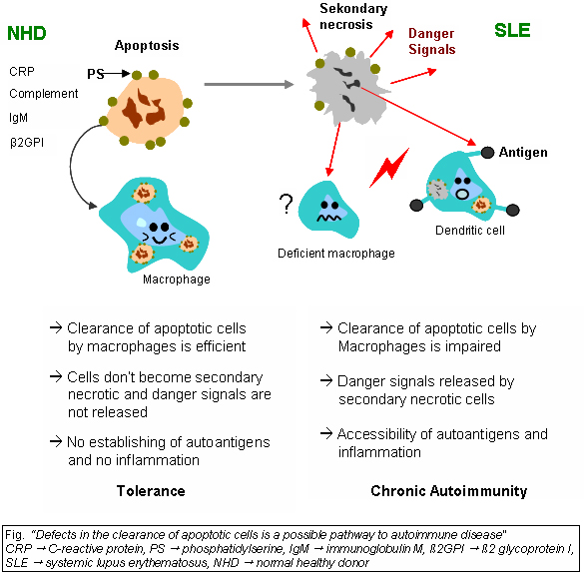
SLE Mechanism: Deficiency of apoptotic cell clearance
phagocytosis & lysis
NHD:
Normal healthy donor
PS:
Phosphatidylserine
CRP:
C-Reactive protein

Slide 5
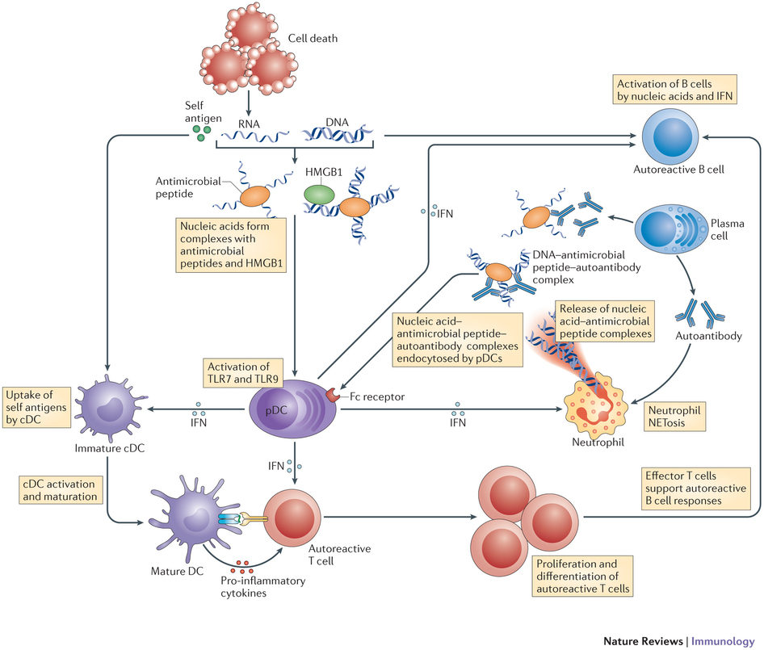
pDC: plasmacytoid dendritic cell
NETs: neutrophil extracellular traps
http://www.nature.com/nri/journal/v13/n8/fig_tab/nri3477_F2.html

Slide 6
http://www.nature.com/nri/journal/v13/n8/fig_tab/nri3477_F2.html

Slide 7
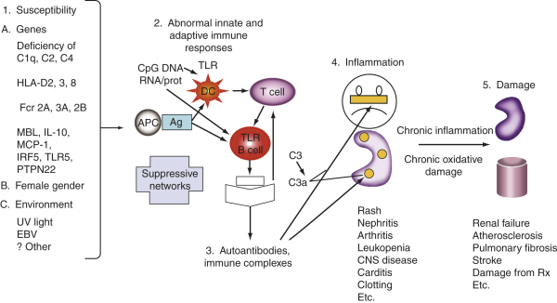
http://mulla.pri.ee/Kelley's%20Textbook%20of%20Rheumatology,%208th%20ed./HTML/550.htm

Slide 8
Poorer Prognostic Factors
Renal disease (especially diffuse proliferative glomerulonephritis)
Hypertension
Male
Young age
Older age at initial presentation
Poor socioeconomic status
Presence of antiphospholipid antibody/antiphospholipid syndrome
Higher overall disease activity

Slide 9
ANA (anti-nuclear antibodies)
anti-ds DNA (native)
anti-ss DNA
RNA autoantibodies
anti-SM
anti-RNP
anti-Ro
anti-La
Antiphospholipid antibodies
anticardiolipin
Antibody against the phospholipid moiety of the prothrombin activator complex
APA provoke blood clots in both veins & arteries as well in pregnancy complications
Anti-Smith antibody is found almost exclusively in people with lupus
Unlike anti-dsDNA, anti-Sm does not correlate with the presence of kidney lupus
Anti-ds-DNA: Anti-double-stranded (native) DNA
High titres of Anti-dsDNA antibodies are specific for SLE and are therefore used in the diagnosis of SLE
Anti-ss-DNA: Anti-single-stranded (denatured) DNA
Anti ssDNA antibody has a higher sensitivity and lower specificity than anti dsDNA antibody for SLE activity
http://www.hopkinslupus.org/lupus-tests/lupus-blood-tests/
https://ww2.rheumatology.org/apps/MyAnnualMeeting/Abstract/33070
http://link.springer.com/article/10.1007%2FBF00541161#page-1

